Slide 1
Decision Making & Stereotypes
EPSY 220
TA: Matt King
Class 2
Thursday, October 20th

Slide 2
Spotchecking:
What are Marcia’s 4 Statuses of Identity Formation/Achievement?

Slide 3
James Marcia’s Theory of Adolescent Identity Formation (continued)
Crisis No Crisis
Commitment Identity Identity
Achievement Foreclosure
No Moratorium Identity
Commitment Diffusion

Slide 4
Attendance/Participation Q:
What are Super’s 5 Stages of Career Development?
G
E
E
M
D
Can you only go through them once?

Slide 6
Activity I
Write down three important decisions you have made (in the past year)
Rank the importance of each decision
Discuss with a partner:
What factors (internal/external) influenced your decisions?
How did you make this decision?
What’s the best way to make a decision?

Slide 7
Obstacles to Decision Making
What assumptions might hinder your ability to make decisions?
What are external obstacles to making decisions?
What are internal obstacles to making decisions?
--We can’t always make a planful decision because of these obstacles

Slide 8
Facts about Decision Making:
Decision making cannot be avoided; even choosing not to decide is a decision.
We make hundreds of decisions daily.
Not all decisions are equally important. The more important the decision, the harder it may be to make.
Important decisions often create anxiety; BUT some anxiety is necessary for optimal decision making.
Most decisions involves risk.

Slide 9
3 Kinds of career decision makers
1. Decided—decision made (Real vs. False)
2. UN-decided—no decision made yet (Comfortable vs. Uncomfortable)
3. IN-decided—unable to make decision (anxiety and low self-confidence in making decision)

Slide 10
Decision-Making Strategies
Self known Self Not known
Planful
Decisions
Dependent Decisions
Environment Known
Environment Not Known
Intuitive Decisions
Confusion /Paralysis

Slide 11
Decision Making Strategies: Pitfalls…
Self known Self Not known
Planful
Decisions
Delaying;
Fatalistic
Environment Known
Environment Not Known
Impulsive;
Complian
Agonizing

Slide 12
Process of Decision-Making (CASVE)…
Communication
Analysis
Synthesis
Valuing
Execution

Slide 13
The CASVE CYCLE
1. Communication (internal and external)—know there is a problem &, thus, a decision to make (problem)
2. Analysis—gathering and analyzing information about self and information of options (cause)
3. Synthesis—integrating information and create alternatives (expanding then narrowing) (solutions)
4. Valuing—weighing all the options based on several factors; prioritizing; committing to a decision (decision)
5. Execution—planning, try-out, and applying (action)

Slide 14
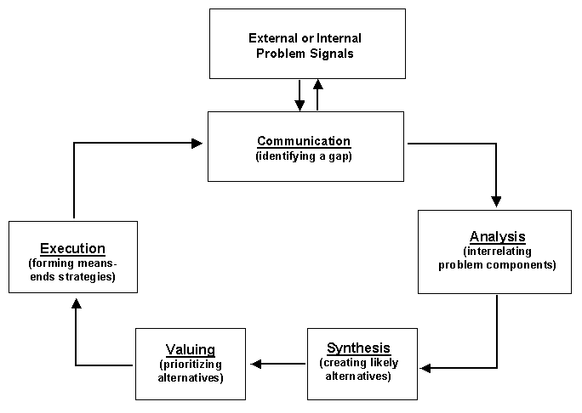
The CASVE CYCLE (Cont.)

Slide 15
CASVE Case Study
Jane enters her freshman year with no clear decision about a major. She enjoys helping people and feels a sense of accomplishment in her work. She feels it is important to serve her community. She is a good writer and likes to run track. She feels like her interests are “all over the place”, but has thought about careers in nursing or education. She’d love to coach track but worries she wouldn’t be able to support herself. Her parents seem to disapprove of her coaching track and she feels pressured to choose a major because her family’s finances are tight and she doesn’t want to stay in college more than 4 years.
Consider how Jane might proceed in making an informed and satisfying decision about choosing a major using the CASVE model. What might occur at each stage?
Communication (identifying the problem)
Analysis (understanding self and options)
Synthesis (expanding and narrowing the solutions)
Valuing (weighing options, making decision)
Execution (action, evaluation)

Slide 16
Stereotypes

Slide 17
What is a stereotype?
“A conceptualization of another person based on a group s/he belongs to that we use to guide our interactions in the absence of other information”

Slide 18
Why is it important to cover stereotypes in a career development class?
Helpful to understand how stereotypes may impact initial (and ongoing) decisions about majors, careers, and options
Increase awareness of how stereotypes may affect your perceptions of co-workers and bosses and how you may be stereotyped by co-workers and bosses
Notes:
We will do 2 activities then discuss our reactions. Please be respectful.

Slide 19
Activity I
Divide into groups; each group picks up 1 slip of paper
On a sheet of paper, write down the stereotypes & stereotypical occupations of the group written on the post it
Do not share the name of your group with other groups (and speak quietly)
The class will guess your group
Notes:
DON’T GIVE OUT ALL SLIPS OF PAPER

Slide 20
Discussion
What was it like coming up with these stereotypes? How did you feel when you heard a stereotype about a group you identify with?
How long did it take for you to come up with these stereotypes?
How might stereotypes impact how others perceive people in your group? You?
How might stereotypes impact your perceptions of occupations?

Slide 21
Keep in Mind
Stereotypes:
Are pervasive and powerful
Cut across boundaries
Are directly and indirectly related to careers
Are automatic (often unconscious) and easily accessible

Slide 22
Stereotypes vs. Cultural Awareness/Knowledge
Why do we stereotype?

Slide 23
Lee, Jussim, McCauley (1995)
Why stereotypes are wrong?
Stereotypes are exaggerations of real group differences
Stereotypes are ethnocentric
Stereotypes imply genetic origins of group differences (as opposed to environmental origins)
Stereotypes lead to biased perceptions of individuals
Notes:
(1995)’s article “why study stereotype accuracy?”

Slide 24
Lee, Jussim, McCauley (1995)
What are the consequences?
Stereotypes lead people to ignore individual differences
“They all look alike to me” (out-group homogeneity effect)
Stereotypes can create & reinforce self-fulfilling prophecies
Eye-color experiment (Jane Elliot)
“Stereotype threat” & test scores

Slide 25
Fundamental Attribution Error
Placing more emphasis on internal rather than external causes/explanations for people’s behavior, or the behavior of people belonging to a particular group
In other words, we often focus more on people’s innate/biological characteristics when making causal inferences rather than considering the situational factors at work
https://www.youtube.com/watch?v=HR_q96-YRzk (1 min video)

Slide 26
Eagly’s (1987) Social Role Theory
Gender roles are important to socialization and are acquired in early childhood.
They are practiced and elaborated throughout childhood and adolescence.
During this time, gender roles introduce sex differences in behavior by acting as normative pressures that encourage sex-typed behavior.
Stereotypically masculine and feminine roles and occupations lead to actual differences in personality and social behavior.

Slide 27

Skills Associated with Successful Male Performance
Assertive
Aggressive
Independent

Slide 28

Skills Associated with Successful Female Performance
Communal
Social
Nurturing
Notes:
Switch to printed notes

Slide 29
Gender Role Conflict
“A psychological state in which socialized gender roles have negative consequences on the person or others” (O’Neil et al., 1995)
Can occur when rigid gender norms or stereotypes result in personal restrictions, devaluation, or personal violations
How may these impact your career decision-making?

Slide 30
Microaggressions
Small, often unconscious behaviors can have a big impact
https://www.youtube.com/watch?v=hDd3bzA7450 (2.5 min video)
https://www.youtube.com/watch?v=h_lQNI9T6vs (3 min video)

Slide 31
Can Stereotypes Ever Be Good/Helpful?
Visiting a different country (awareness of cultural norms)
Positive stereotypes
While being aware of other side

Slide 32
Conclusions
We all stereotype to some degree
Generalizations allow us to simplify the world
Thinking about why we stereotype, and identifying stereotypes, can be helpful
Stereotypes can influence career choices and experiences
We can avoid/minimize harmful stereotyping by examining individual differences within cultures/groups that always exist
Notes:
Talk to me for more resources or recommendations.
5 min break

Slide 33
Upcoming Due Dates
Due After Break
Career Autobiography Presentations!
Due March 28th
Major / Grad School / Internship Exploration

